Slide 1
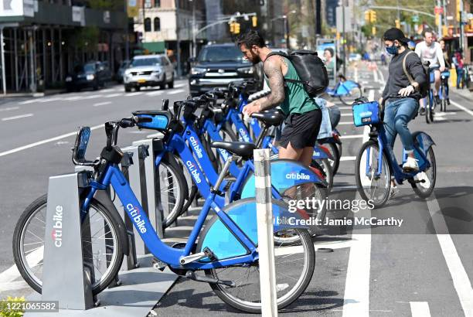
Cyclistic Bike Share Analysis
By
Shabeeb Althaf M B
Batch- MBT8

Slide 2
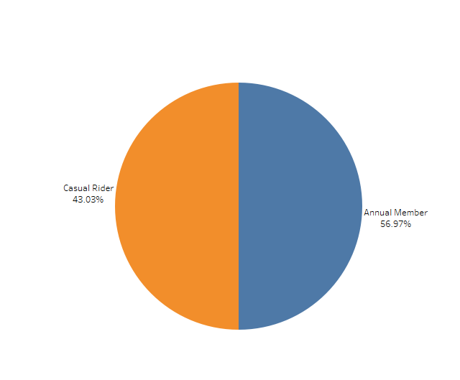
This pie chart illustrates the distribution between two groups of riders: 1.Casual Riders and Annual Members. 2.The blue section represents Annual Members, accounting for 56.97% of the total, while the orange section signifies Casual Riders, making up 43.03%. 3.This suggests that more than half of the users are committed to annual memberships, reflecting a stronger preference for consistent, long-term use of the service. 4.The gap between the two groups is not extremely wide, showing that there is still a significant portion of casual, less frequent riders, which could indicate diverse patterns in how people utilize this particular service.

Slide 3
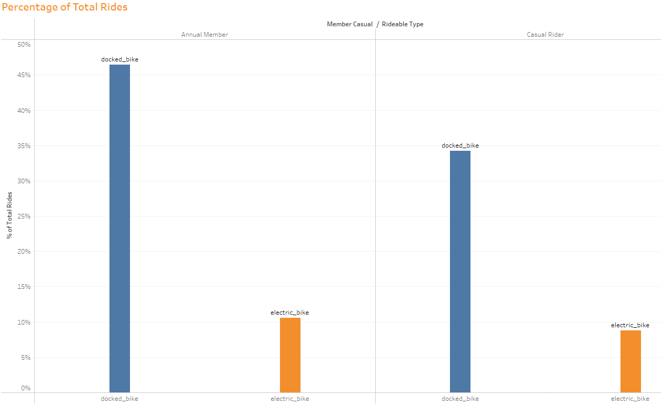
This bar graph shows the percentage of total rides taken by Annual Members and Casual Riders using two types of bikes: 1.Docked bikes and electric bikes. 2.For both groups, docked bikes dominate the total rides. 3.Annual Members use docked bikes significantly more, accounting for nearly 45% of the total rides, while their use of electric bikes is much lower. 4.Casual Riders follow a similar pattern but use electric bikes more than Annual Members. 5. The graph indicates that docked bikes are the preferred choice for both user groups, but Casual Riders are more inclined toward electric bikes compared to Annual Members.

Slide 4
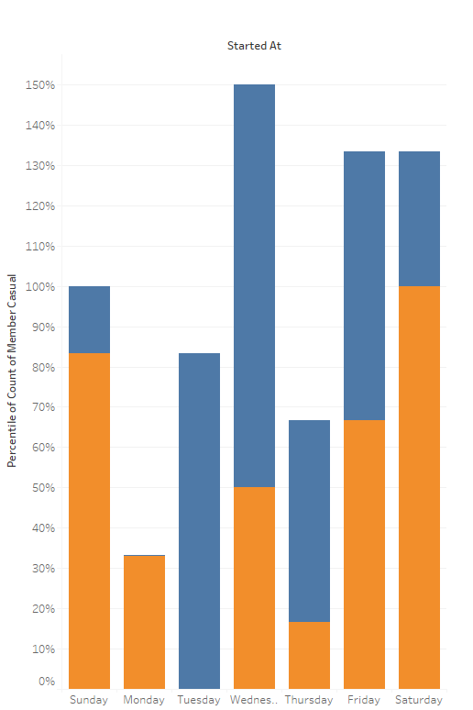
Share of Rides by Days
This bar graph displays the day-wise distribution of rides taken by Annual Members (blue) and Casual Riders (orange).
On weekends (Saturday and Sunday), Casual Riders account for a larger portion of total rides, peaking on Saturday.
In contrast, Annual Members have a higher ride percentage on weekdays, especially on Wednesday, where their usage dramatically spikes above 140%.
This suggests that Annual Members are more active during the workweek, while Casual Riders prefer weekends for bike usage.
The trend highlights differing riding patterns between the two groups, with weekday commuting likely dominating Annual Members' behaviour, while leisure riding defines Casual Riders.

Slide 5
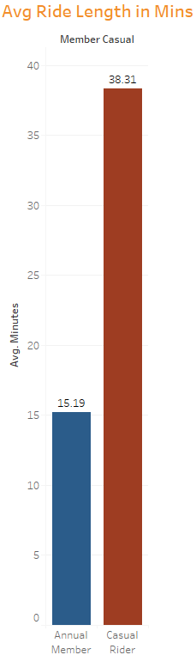
The bar graph illustrates the average ride length in minutes for annual members and casual riders of a bike-sharing service. 1. It reveals that casual riders have a significantly longer average ride time of 38.31 minutes compared to annual members, who average 15.19 minutes per ride. 2. This disparity suggests that casual riders might use the service for more leisurely or extended trips, while annual members likely use it for shorter, possibly more routine commutes. 3. Understanding these usage patterns can help the service tailor its offerings to better meet the needs of both user groups.

Slide 6
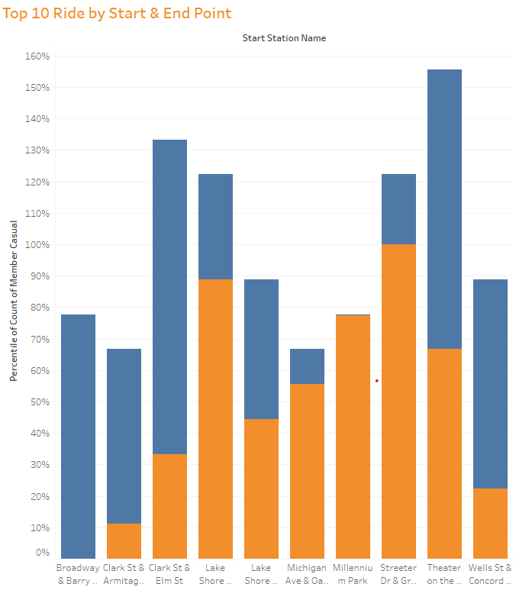
This bar chart titled “Top 10 Ride by Start & End Point” provides a fascinating visual representation of travel patterns. 1. It highlights the percentage of cumulative casual rides originating from various start stations like Broadway, Clark St & Elm St., and Lake Shore Dr. 2. Each station is paired with different endpoints, showing the distribution of rides. 3. The varying bar heights make it easy to compare the popularity of different routes. 4. This data can be incredibly useful for transportation planning and understanding commuter behavior. 5.Overall, it’s an insightful snapshot of urban mobility trends.

Slide 7
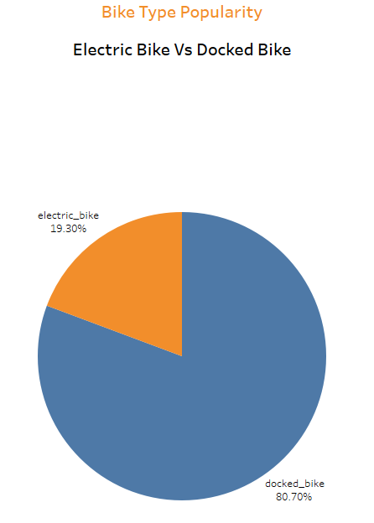
This pie chart titled “Bike Type Popularity” reveals a significant preference for docked bikes, which make up 80.7% of the total, compared to electric bikes at 19.3%. 1. The stark contrast highlights the current consumer trend favoring docked bikes. 2. This could be due to various factors such as cost, availability, or user familiarity. 3. Understanding these preferences is crucial for urban planners and bike-sharing companies aiming to optimize their services and infrastructure. 4. As electric bikes continue to evolve, it will be interesting to see if this trend shifts in the future.

Slide 8
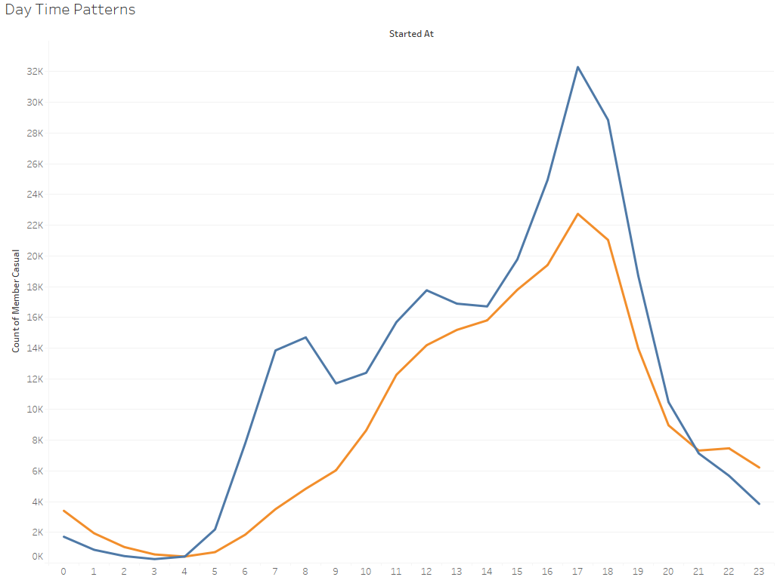
This line chart titled “Day Time Patterns” illustrates two distinct trends, represented by blue and orange lines. 1. Both lines start at 4 am and show activity levels over a 24-hour period. 2. The blue line peaks in the late afternoon, while the orange line peaks around midday. 3. Both lines start low in the early hours, rise sharply, and then decline towards the evening. 4. The chart suggests two different patterns of behavior with similar shapes but different peak times and magnitudes. 5. This could indicate varying daily routines or activities that are time-shifted but follow a similar overall pattern.

Slide 9

Conclusion: 1. Annual Members account for the majority of the rides with 56.97% of total rides coming from them, casual riders account for 43.03% of the rides 2.Rides of casual riders are on average longer than Annual members. This is expected and in line with leisure oriented use by casual riders. 3.Casual riders prefer to ride over the weekend, while Annual members use bikes throughout the week. This can be explained by the fact that annual members use bikes to commute to work places. While casual riders use it more for adventure. 4.Number of rides of annual members peak at around 6AM to 9AM and 4PM to 6PM, This clearly indicates they use bikes for work commute, Casual riders use bike mostly in the evening. 5.There is no such peak hours in the weekends, both type of riders use bikes towards the evening during weekend. 6.Streeter Dr & Grand Avenue is the most busy station, with around 80% of riders on this station are from casual riders. Beach and Museum around this location might be the reason for this.

